Slide 1




SECBERG
GTU SBTP -2026 (Subject Code: DI05000011)
NAME: ANKIT MANOJBHAI VAGHELA
GENDER: MALE
ENROLLMENT NO: 246490316224
REGISTERED EMAIL: ankitvaghela990@gmail.com
CONTACT NO. 9824117697
COLLAGE NAME: SIR BHAVSINHJI POLYTECHNIC INSTITUTE
BRANCH: INFORMATION TECHNOLOGY
BRANCH CODE: 016
YEAR: 3RD YEAR

Slide 2

Learnings
01
Cyber Fundamentals:
Gained deep insights into cybersecurity architecture, how threats manifest globally, and why data security is paramount in the modern age.
02
Offensive Demo:
Mastered Kali Linux installation and explored real-world threat vectors like Phishing through live, controlled demonstrations.
03
AI-Driven logic:
Leveraged AI to bridge Frontend/Backend logic, helping me think differently about problem-solving and rapid tool building.

Slide 3

Project Purpose
Why SecBerg?
Traditional security tools are often heavy, cloud-dependent, and complex for developers. SecBerg was built to provide a lightweight, localized "Command Center" for proactive auditing.
The primary goal is Privacy-First Intelligence, allowing developers to identify misconfigurations long before code touches production servers.

Slide 4


Project
Objectives
Vulnerability Scanning: Automate the auditing of critical HTTP security headers (HSTS, CSP, X-Frame) against OWASP benchmarks.
Real-Time Monitoring: Stream SSH auth logs to spot burst-attack patterns and brute-force campaigns in real-time.
Local Network Mapping: Provide safe, localized port and service enumeration to find exposed daemons on private assets.
Crypto Analysis: Mathematically evaluate string randomness and entropy to detect leaked API keys or weak secrets.

Slide 5


Development Steps
Phase 1
Phase 2
Phase 3
Phase 4
Phase 5
Architecture Design & Security Pattern Research.
Python/FastAPI Backend & Scraper Engine Building.
React UI Design with Tailwind & Dark-Mode Logic.
Full-Stack API Integration & Telemetry Sync.
GitHub Pushing & Vercel/Render Deployment.

Slide 6



Github Link:
https://github.com/ANKITVAGHELA990/SecBerg-toolkit
Website Link:
https://secberg-toolkit.vercel.app

Slide 7
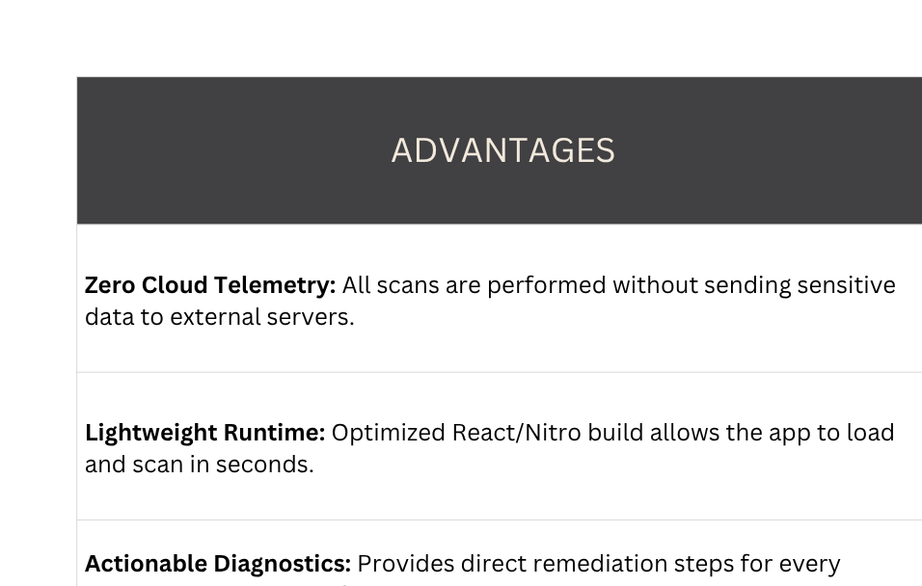

Slide 8
Technical
Hurdels
Encountered 404 errors on Vercel deployment due to the new TanStack Start full-stack architecture. Resolved by migrating from static rewrites to a native Nitro serverless configuration.
Maintaining visual consistency across deeply nested charts and input components in dark mode was challenging. Implemented dynamic stroke coloring to ensure perfect contrast.

Slide 9

Project
Calculation
"Security is not a final destination, but a continuous journey of intelligence. SecBerg simplifies this journey for developers."
This program and project have bridged the gap between defensive theory and real-world implementation, proving that AI-assisted full-stack development is the future of cybersecurity engineering.

Slide 10


Thank you
SECBERG: MINIMALISM IN SECURITY INTELLIGENCE
E-mail
ankitvaghela990@gmail.com
LinkedIn
www.linkedin.com/in/ankitvaghela09
Portfolio
www.linkedin.com/in/ankitvaghela09

